Slide 1
Week 8
Tuesday 9/26 – Friday 9/29
Odd/Even

Slide 2
Activating prior knowledge…
What does it mean to be a hero? Who are your heroes?
What are some legends that you have heard of? How are they similar to fairytales?

Slide 3
Which of the terms are you familiar with? Come up to the board and write a definition or explanation of the term (heck, you can even draw a picture)
Cerberus
Charybdis
Sphinx
Minotaur
Gorgons
Nike
Apollo
Achille’s heel
“It’s all Greek to me”
A Herculean task

Slide 4
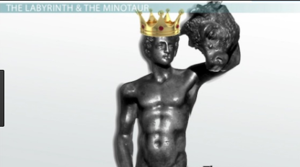
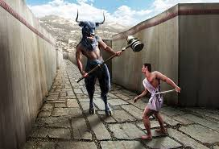
Based on the representations of Theseus below, make a prediction about the text.

Slide 5
Character Education: Self-control
Agenda Message: Tutoring is available Tuesdays at 7:45, Wednesday until 4:10, and by appointment
Homework: Write sentences for all 10 vocabulary words.
Standards: SL4 (presents information logically to a group), RL4 (determines meaning), RL5 (analyzes author’s choices in structuring a text)
UPCOMING: Read Theseus and complete activity, Review for Unit 1 Test, Take Unit 1 Test, Take and CDA 1.

Slide 6
Essential Question – What obstacles and trials does Theseus face on his quest? Based on Thesus’ actions during the quest, how would he be characterized in comparison to other heroes we have studied in this unit?
Read “Theseus” pgs. 29-33. On a note card, complete Freytag’s pyramid for the events of the plot.
Your assignment is a mystery…but know this, you will not be able to use your book or the brain of another student to complete this task. It will simply be YOU and your notecard (insert ominous music).

Slide 7
Summarizer
Of the heroes we have studied thus far, which would you prefer to lead you in battle? Why? Justify your reasoning.

Slide 8
Thursday/Friday
Students will complete a study guide for the Unit 1 Test. Students can attend tutoring for help preparing for the test.

